Slide 1
List Processor
2020.11.19

Slide 2
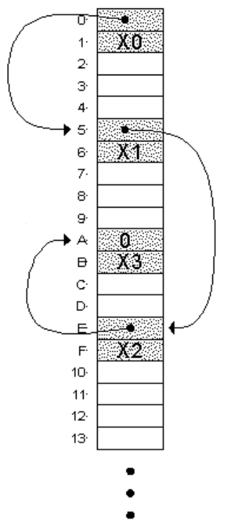
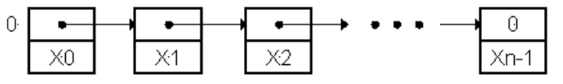
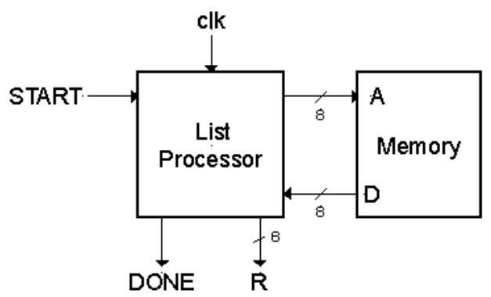
Problem Specification
Design a circuit that forms the sum of all the integers stored in a linked-list structure starting at memory address 0

Slide 3
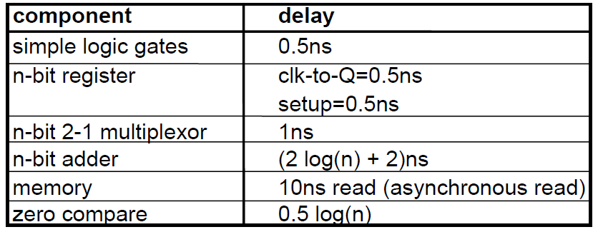
Other Specifications
Design Constraints
  Usually the design specification puts a restriction on cost, performance, power or all.
Component Library

Slide 4
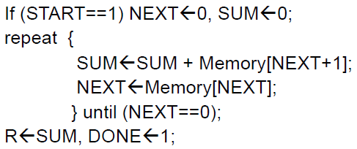
Architecture #1
Algorithm
Datapath
0
NEXT_SEL
1
0
+
0
LD_NEXT
<
A_SEL
D
SUM_SEL
NEXT
1
0
Memory
1
0
LD_SUM
<
A
SUM
+
1
= = 0
NEXT_ZERO

Slide 5
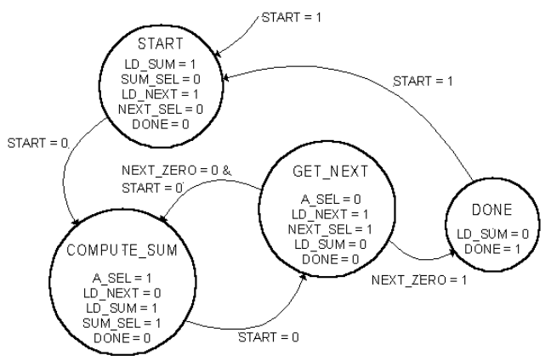
Controller State Diagram

Slide 6
States － START
LD_NEXT, LD_SUM
0
NEXT_SEL
1
0
+
0
LD_NEXT
<
A_SEL
D
SUM_SEL
NEXT
1
0
Memory
1
0
LD_SUM
<
A
SUM
+
1
= = 0
NEXT_ZERO

Slide 7
States － COMPUTE_SUM
A_SEL, SUM_SEL, LD_SUM
0
NEXT_SEL
1
0
+
0
LD_NEXT
<
A_SEL
D
SUM_SEL
NEXT
1
0
Memory
1
0
LD_SUM
<
A
SUM
+
1
= = 0
NEXT_ZERO

Slide 8
States － GET_NEXT
NEXT_SEL, LD_NEXT
0
NEXT_SEL
1
0
+
0
LD_NEXT
<
A_SEL
D
SUM_SEL
NEXT
1
0
Memory
1
0
LD_SUM
<
A
SUM
+
1
= = 0
NEXT_ZERO

Slide 9
Controller Implementation
<
START
START
LD_SUM
<
NEXT_ZERO
COMP
SUM
SUM_SEL
A_SEL
<
LD_NEXT
GET
NEXT
NEXT_SEL
START
<
START
DONE
DONE

Slide 10
Analysis of Performance
COMPUT_SUM state
setup
CLK
8-bit add
memory
15-bit add
CLK-Q
MUX
MUX
NEXT
.5
8
1
10
31 ns
10
1
.5
GET_NEXT state
T > 31ns
F < 32Mhz
CLK
control output delay
== 0
MUX
MUX
memory
control input delay
A_SEL
NEXT_ZERO
.5
1
10
15.5 ns
1
1.5
1.5

Slide 11
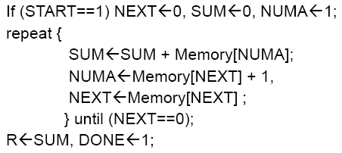
Architecture #2
LD_NEXT, LD_SUM, LD_NUMA
A_SEL, SUM_SEL, LD_SUM
NEXT_SEL, LD_NEXT
0
NEXT_SEL
1
0
+
0
LD_NEXT
<
A_SEL
D
SUM_SEL
NEXT
1
0
Memory
= = 0
0
LD_SUM
<
1
A
SUM
1
NEXT_ZERO
+
1
NEXT_SEL
1
0
LD_NEXT
NUMA
<

Slide 12
Analysis of Performance
COMPUT_SUM state
memory
15-bit add
setup
CLK
MUX
CLK-Q
MUX
NEXT
.5
1
10
10
1
.5
T > 23ns
F < 43Mhz
23 ns
GET_NEXT state
control output delay
setup
CLK
MUX
MUX
memory
8-bit add
A_SEL
.5
1
10
8
1
.5
21 ns

Slide 13
Architecture #3
LD_NEXT, LD_SUM
A_SEL, ADD_SEL, SUM_SEL, LD_SUM
NEXT_SEL, LD_NEXT
1
0
ADD_SEL
1
0
NEXT_SEL
1
0
LD_NEXT
NEXT
<
A_SEL
D
+
Memory
0
A
0
1
1
SUM_SEL
1
0
1
0
NEXT_SEL
= = 0
LD_SUM
SUM
<
>
NUMA
LD_NEXT
NEXT_ZERO

Slide 14
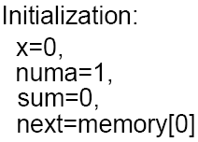
Architecture #4
0
T > 14 ns
F < 71 Mhz
X_SEL
0
0
1
NEXT_SEL
1
1
0
1
0
>
X
LD_X
ADD_SEL1
LD_NEXT
NEXT
<
A_SEL
D
Memory
1
0
0
ADD_SEL2
A
= = 0
1
+
0
1
NEXT_ZERO
SUM_SEL
0
1
1
0
NEXT_SEL
LD_SUM
SUM
<
>
NUMA
LD_NUMA

Slide 15
The End

